Slide 1

Code review with Git & R
Rosanne Timmerman & Anna Henschel
Notes:
https://github.com/brooke-watson/BRRR/issues

Slide 2

“Code review is like peer review for code.”
https://www.youtube.com/watch?v=6qKpbWyb6tg

Slide 3

1. Why do code review?

Slide 4
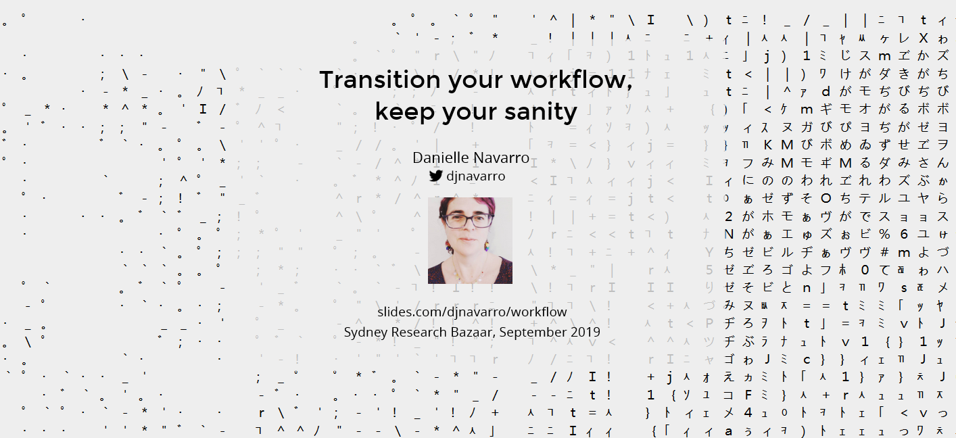
Transitioning the workflow.
https://slides.com/djnavarro/workflow#/

Slide 5
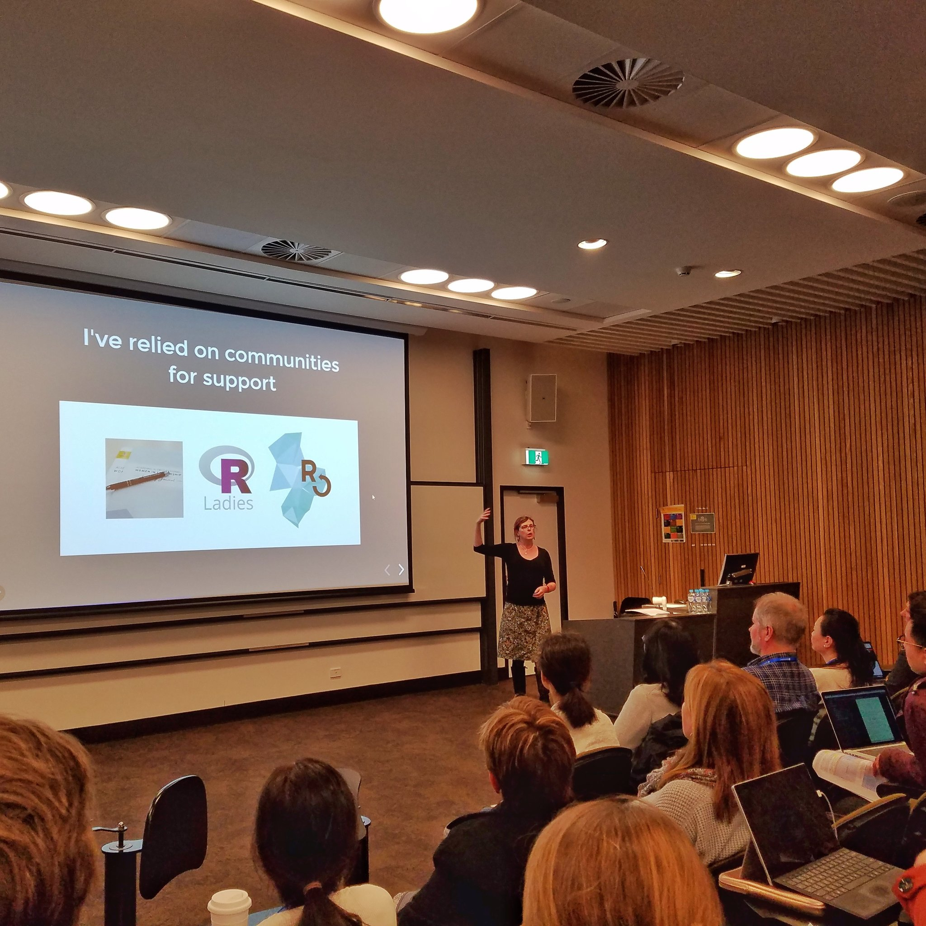
#ResBazSydney19
https://slides.com/djnavarro/workflow#/

Slide 6
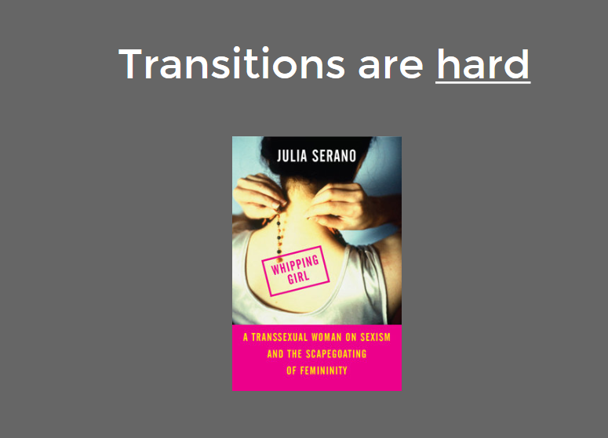
#ResBazSydney19
https://slides.com/djnavarro/workflow#/

Slide 7
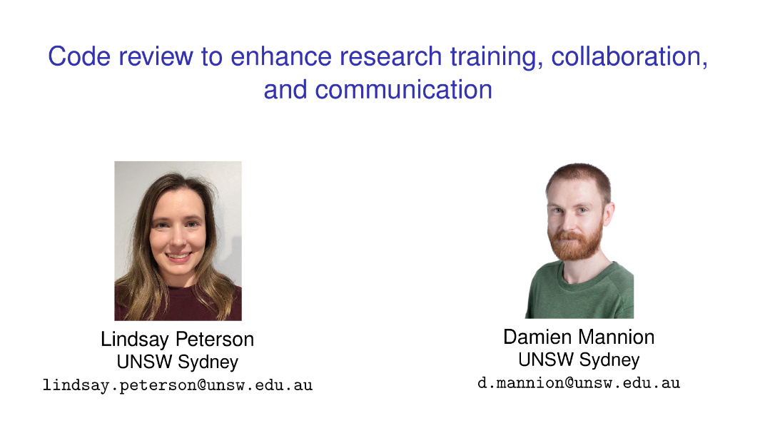
Code review can help you be a better scientist

Slide 8
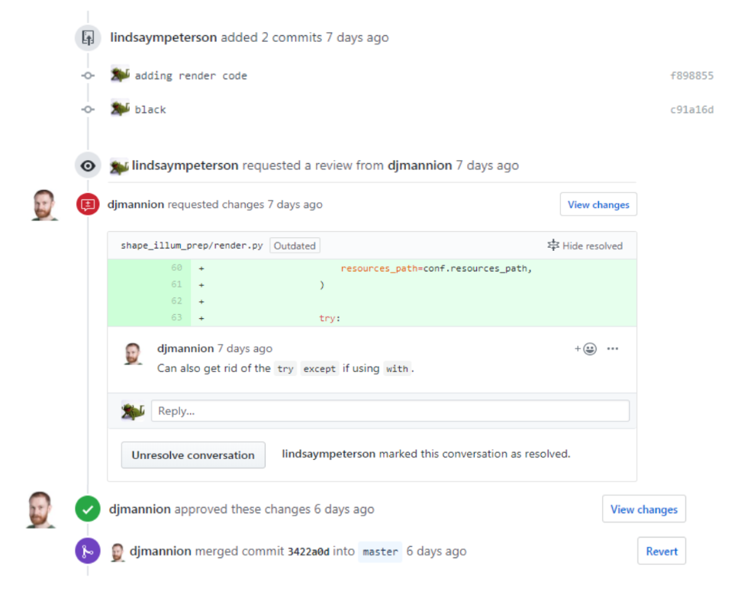

Slide 9
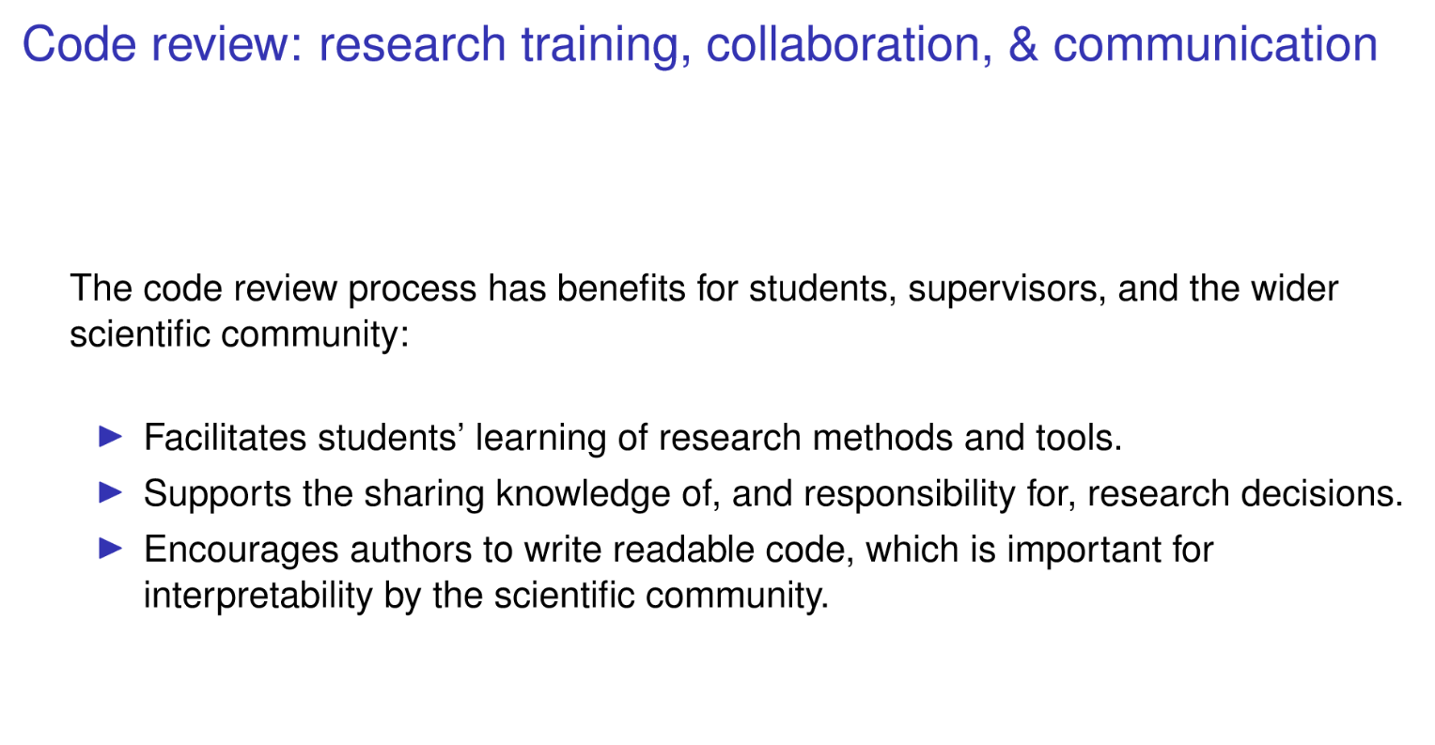

Slide 10
2. Intro to git

Slide 11
Git = the most widely used modern version control system in the world today
Github = a web-based hosting service for version control using git

Slide 12
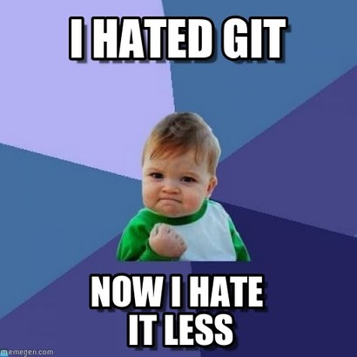

Slide 13

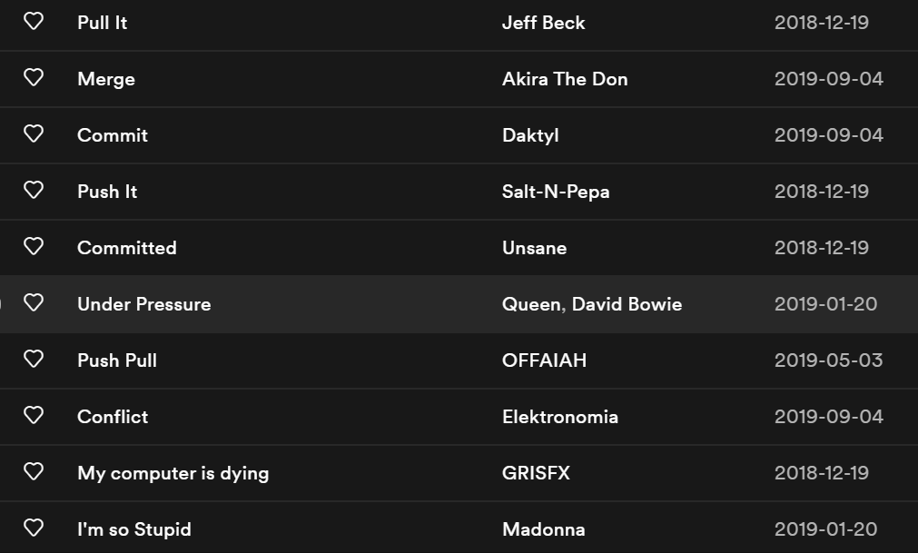
https://open.spotify.com/playlist/0MJBni0UzdnML1amikx0Rc

Slide 14
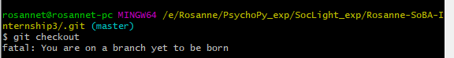
The unexpected poetic side of git:
https://open.spotify.com/playlist/0MJBni0UzdnML1amikx0Rc

Slide 15
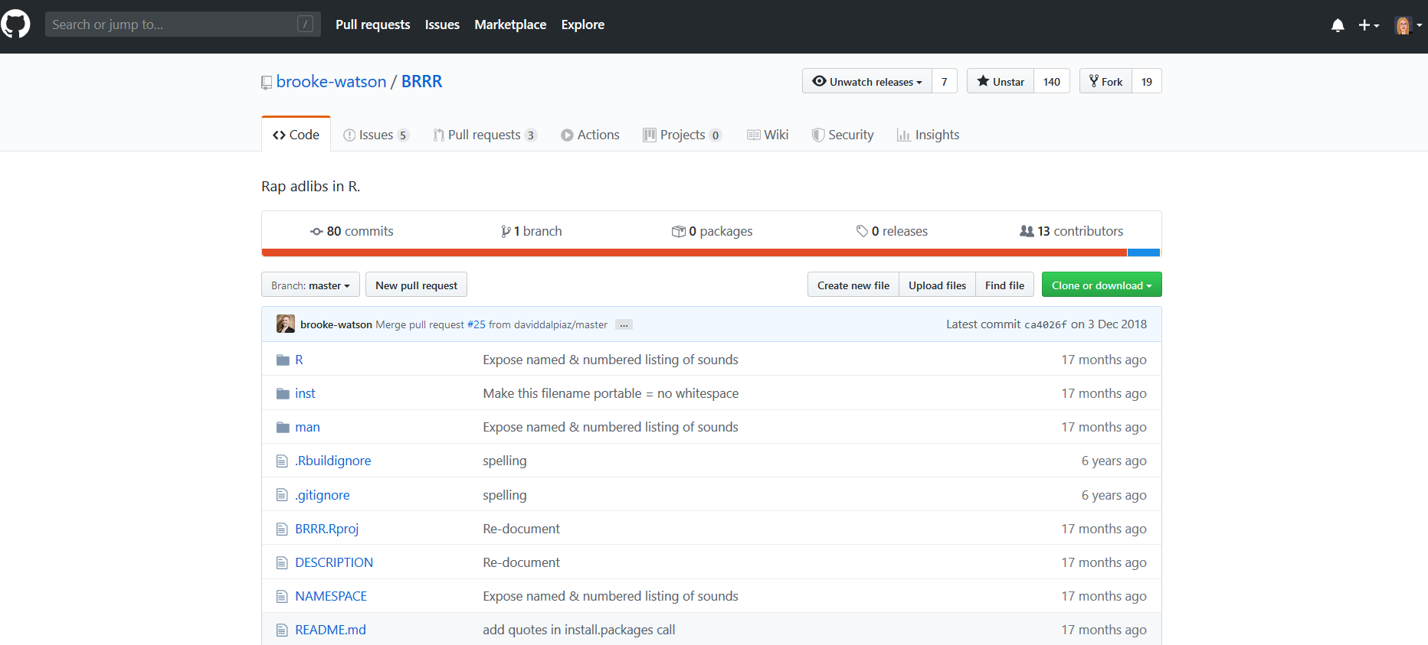
This is a repo:
Short description

Slide 16
This is a repo:
Overview of commits = changes

Slide 17
This is a repo:
Super useful long description

Slide 18
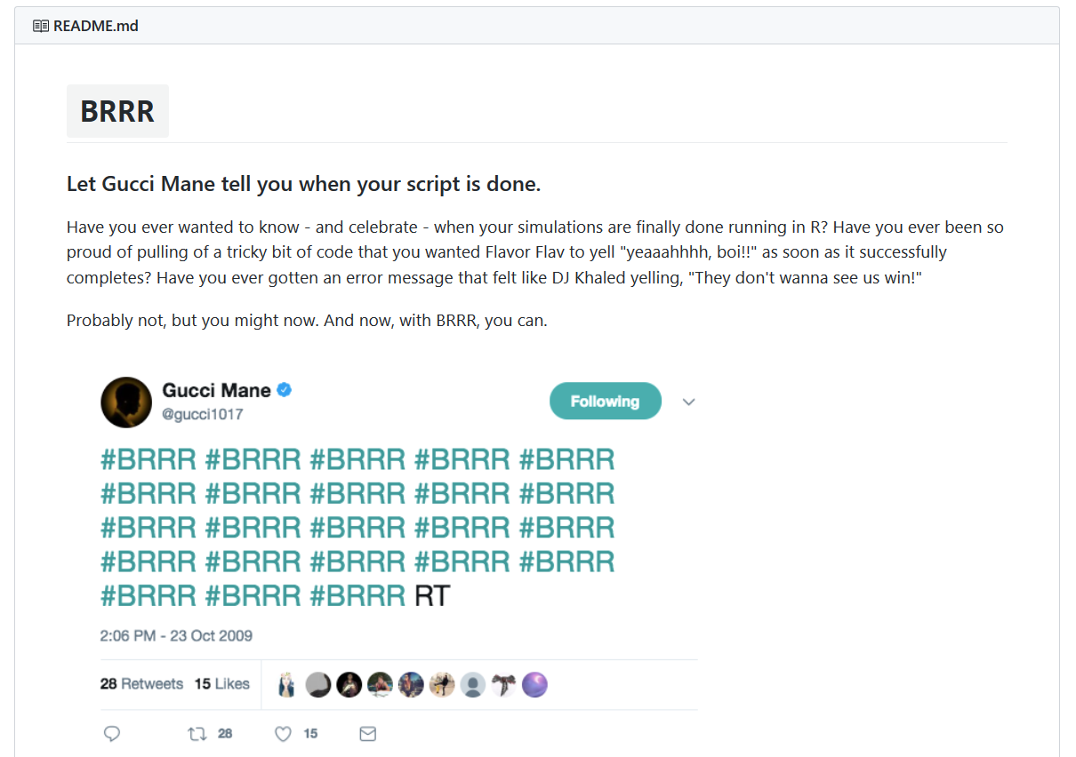
This is a repo:
Super useful long description

Slide 19
This is a repo:
Folder with R scripts

Slide 20
This is a repo:

Slide 21

This is a repo:
https://open.spotify.com/playlist/0MJBni0UzdnML1amikx0Rc

Slide 22

This tutorial walks you through the first steps in git/ Github:
http://brunaw.com/slides/git-workshop/git-workshop.html#1

Slide 23
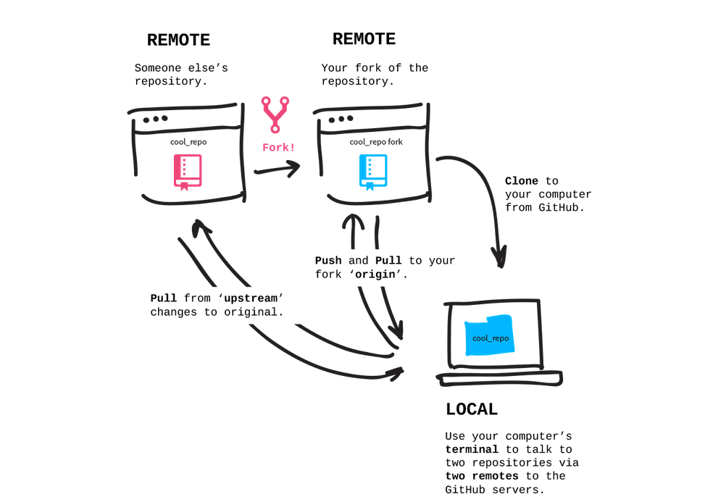
http://brunaw.com/slides/git-workshop/git-workshop.html#1

Slide 24
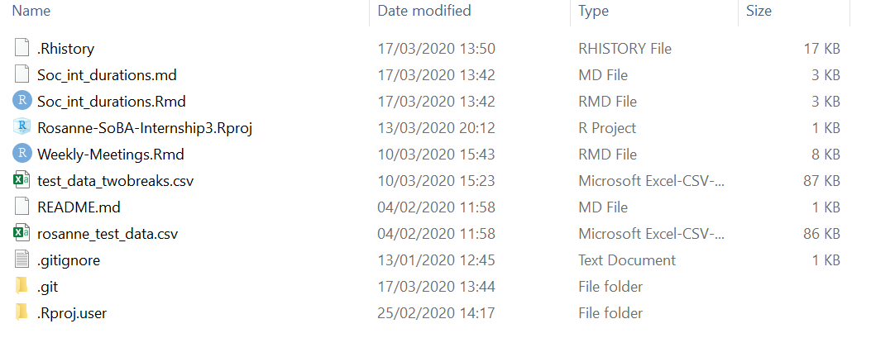
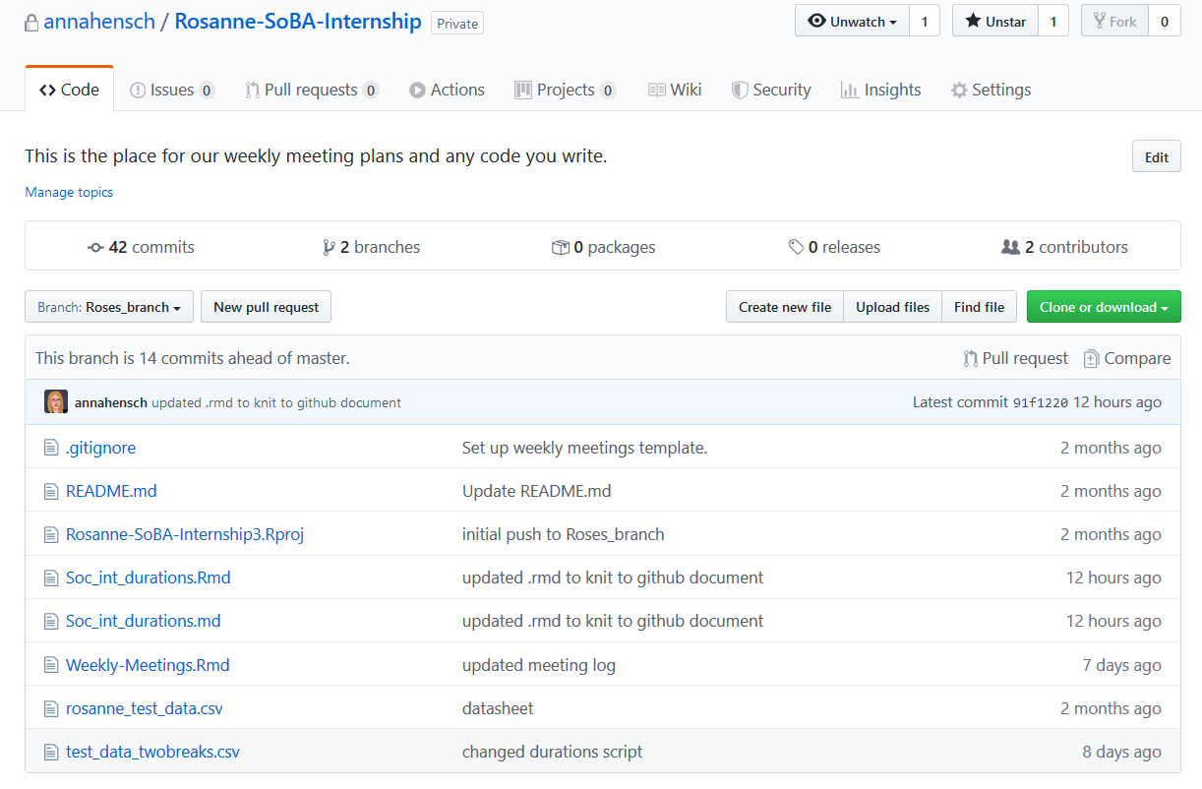
My PC:
Github:

Slide 25
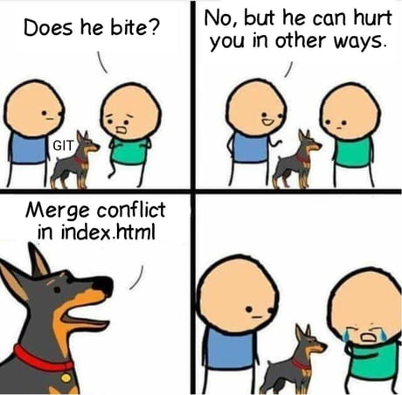
Top advice: keep calm

Slide 26
3. Best practices

Slide 27
Tips (pretty much the same as scientific peer review)
Don’t take it personally
Don’t marry your code
Consider all feedback
Articulate why you made certain choices
Be willing to compromise
Contribute to others code reviews
Thou shalt treat submitters how thou would like to be treated
Thou shalt not be intimidated by the number of comments
Thou shalt not repeat the same mistakes
Thou shalt embrace the nits
https://techbeacon.com/app-dev-testing/10-commandments-navigating-code-reviews

Slide 28
3. Code review demo
https://github.com/annahensch/Rosanne-SoBA-Internship
Notes:
https://github.com/annahensch/Rosanne-SoBA-Internship

Slide 29
4. Concluding thoughts

